Slide 1
Game Pitch Presentation
Mila Bromm and Alex Racey

Slide 2
Idea – Tank based game

Slide 3
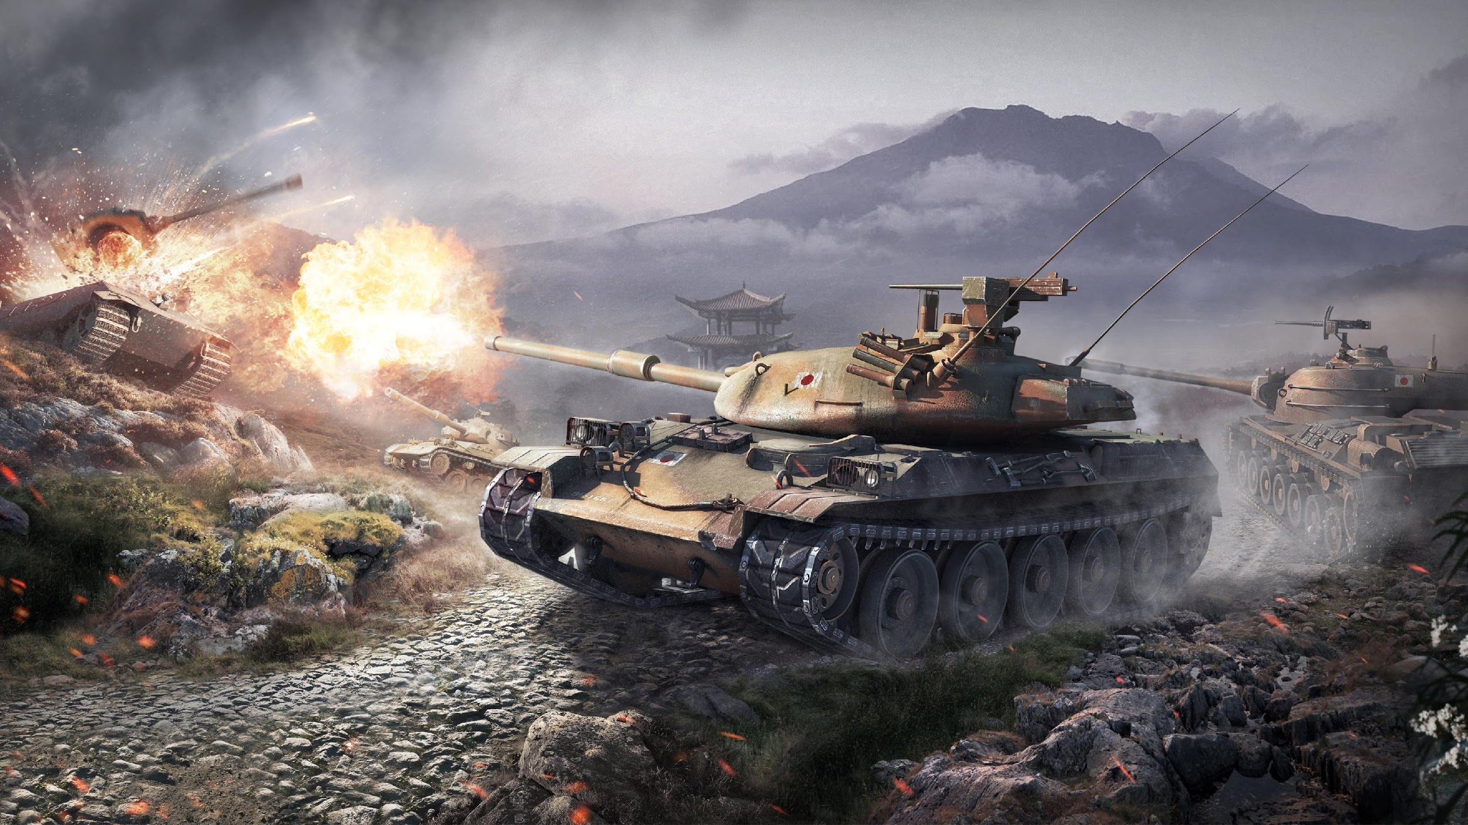
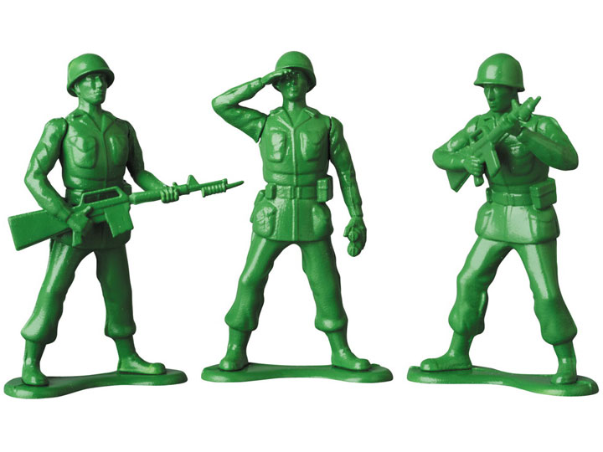
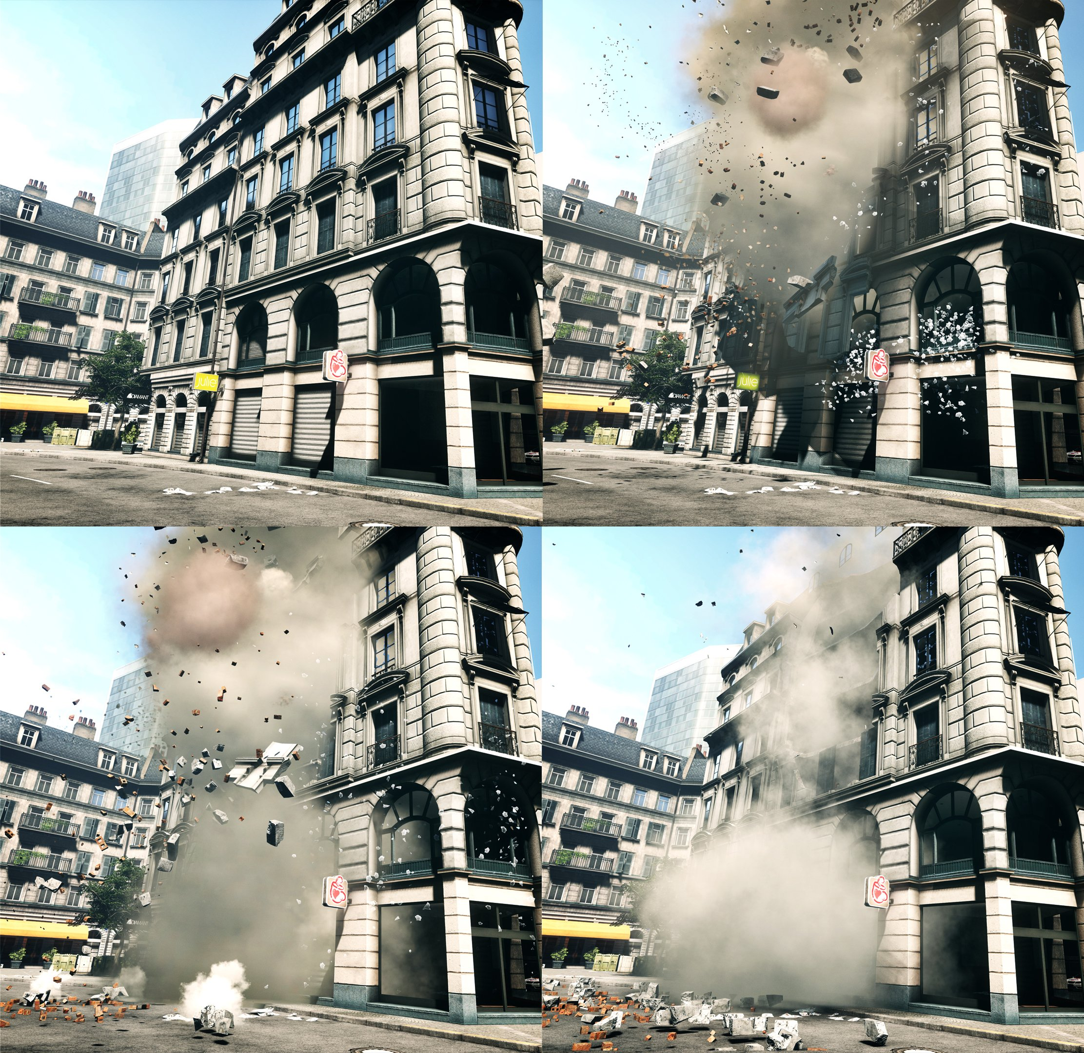
Game Inspiration
World of Tanks – objective based, multiple choices of vehicle
Toy Story – bright colours, toy soldiers, cartoon violence
Battlefield – destruction of environment, buildings removed to create new traversable paths for player

Slide 4
Player experiences
Ability to destroy army of opponents, single-player versus the game interaction
Ability to work against other players to complete an objective (if multiplayer were to be implemented)
Players will experience element of stress as they will be working against a timer
Conflict will be experienced between player and physical environment through contact with obstacles (maze walls) and NPC opponents

Slide 5
Core gameplay idea
Player controlled tank using WASD keys for procedural movement
Mouse used to control tank turret for aiming, separates it from tank movement for increased control
Player must destroy enemy tanks, conversely enemy AI tanks will attempt to destroy player tanks
Maze environment, featuring destructible walls, allowing for new paths that tanks are able to take
Rules associated with player include what areas of environment are destructible, as well as how much time is given to complete the game objective

Slide 6
Game features
Single player interaction
Multiple different levels (mazes), will also act as game boundaries
Score system based on tanks/soldiers hit
Timer running in background, game ends and player fails objective when timer reaches zero
In game resources will include health pickups and power ups to increase damage of weapons and affect player speed
Players work to achieve high score for completing levels in the fastest time – links to the overall game outcome

Slide 7
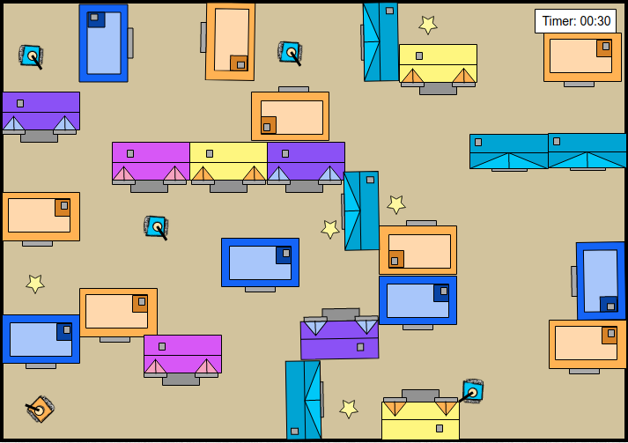
Game Mockup

Slide 8
Possible enhancements
Multiplayer function, allowing up to 4 players in a player versus player interaction pattern
High score scoreboard, saving player scores to a file that can be loaded when the game is reopened
Ability to have procedurally generated levels instead of having to submit manually created levels
Addition of more than one selectable player tank, each vehicle will possess unique properties allowing for differences in gameplay (differences in tank speed, projectile types, etc.)

